Slide 1

The MIP Landscape
By Creatrol & Bolun

Slide 2
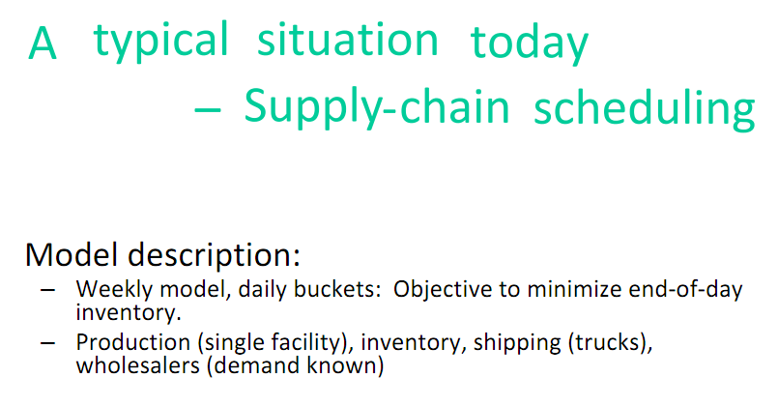
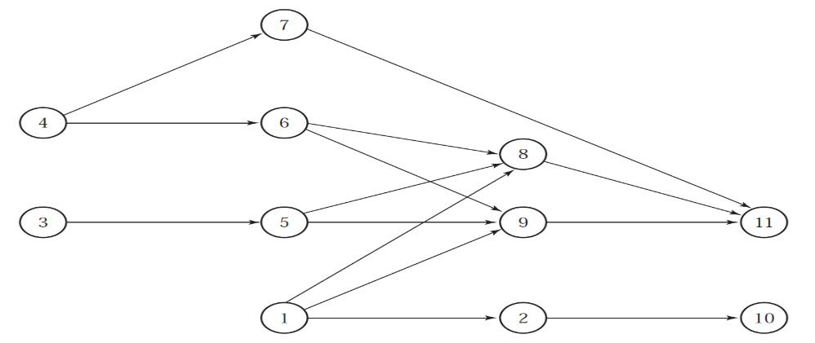
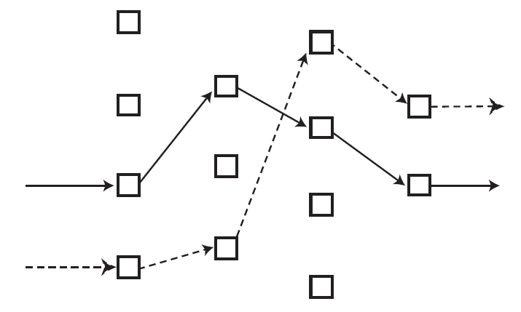

Slide 3
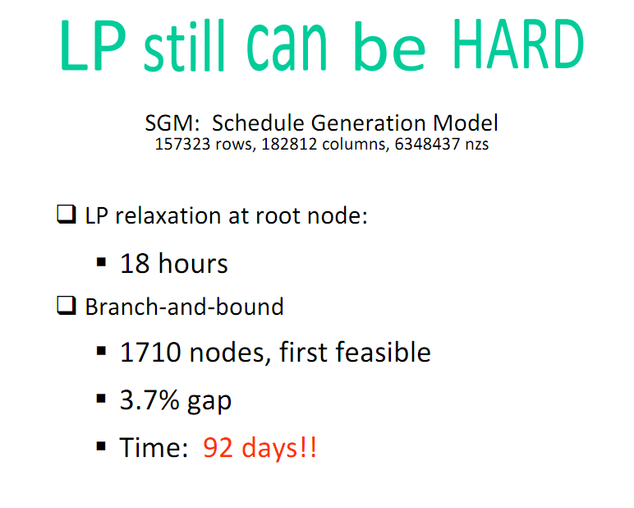

Slide 4
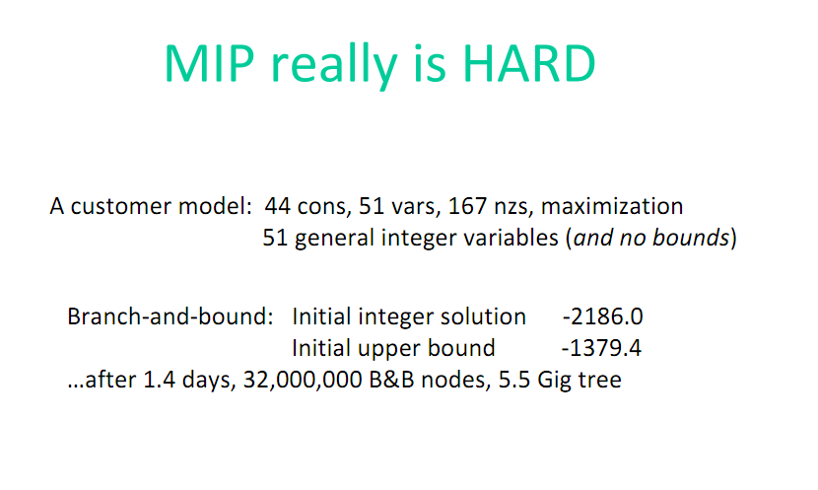

Slide 5
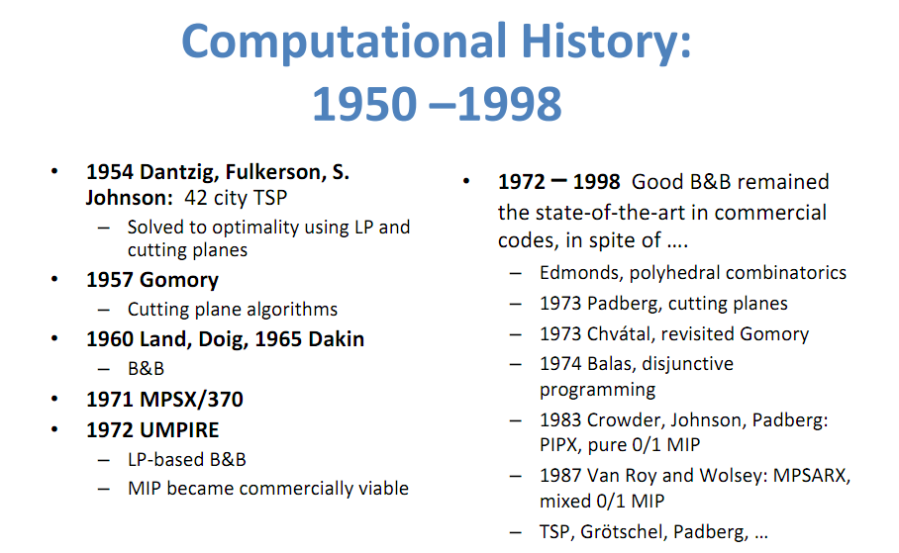

Slide 6
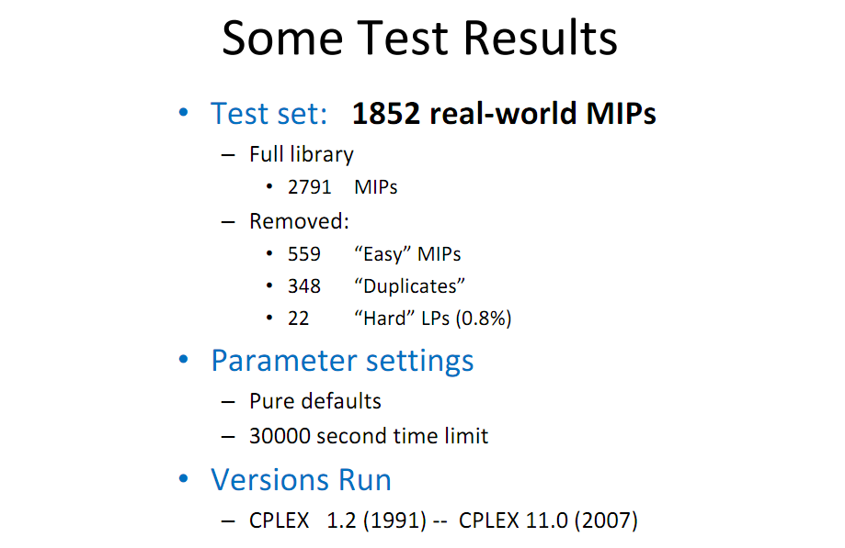

Slide 7


Slide 8
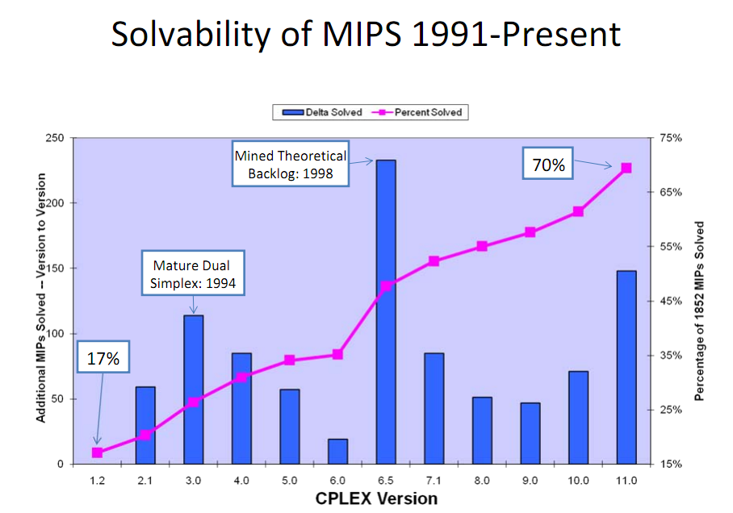

Slide 9
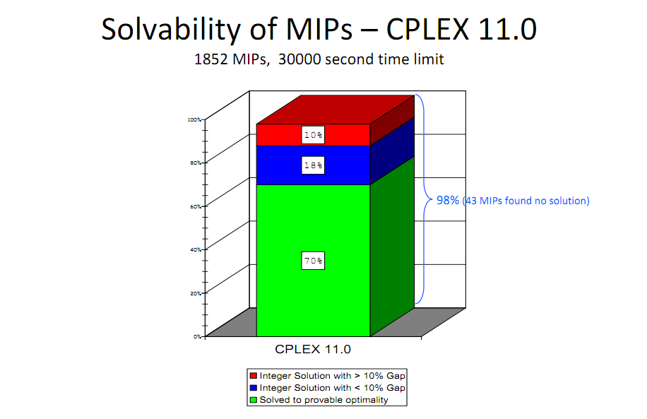

Slide 10


Slide 11
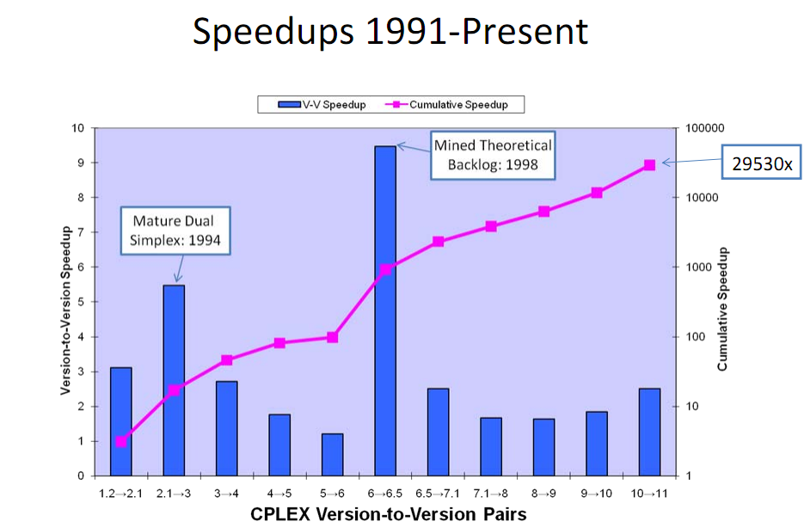

Slide 12
Inferences:
R.J.Dakin.A tree-search algorithm for mixed integer programming problems
Santosh.Kumar&Brian.C.Jones. Fifty Years of Integer Programming: A Review of the Solution Approaches

Slide 13
Thank you for attention

